Slide 1
Topic 10
Software Engineering
資料結構與程式設計
Data Structure and Programming
11/11/2015

Slide 2


Why Software Engineering?
Software development is hard !
Important to distinguish
“easy” systems (one developer, one user, experimental use only) from
“hard” systems (multiple developers, multiple users, products)
Experience with “easy” systems is misleading
  One person techniques do not scale up
Analogy with bridge building:
  Over a stream = easy, one person job
  Over River Severn … ? (the techniques do not scale)
Source: http://www.csc.liv.ac.uk/~igor/COMP201/

Slide 3
Why Software Engineering ?
The problem is complexity
Many sources, but size is key:
  UNIX contains 4 million lines of code
  Windows 2000 contains 10⁸ lines of code
Software engineering is about managing this complexity.
Source: http://www.csc.liv.ac.uk/~igor/COMP201/

Slide 4
What is software engineering?
Software engineering is an engineering discipline which is concerned with all aspects of software production
Software engineers should
  Adopt a systematic and organized approach to their work
  Use appropriate tools and techniques depending on
    the problem to be solved,
    the development constraints and
    the resources available
Source: http://www.csc.liv.ac.uk/~igor/COMP201/

Slide 5
What is a software process?
A set of activities whose goal is the development or evolution of software
Generic activities in all software processes are:
  Specification - what the system should do and its development constraints
  Development - production of the software system
  Validation - checking that the software is what the customer wants
  Evolution - changing the software in response to changing demands
Source: http://www.csc.liv.ac.uk/~igor/COMP201/

Slide 6
What are the attributes of good software?
The software should deliver the required functionality and performance to the user and should be maintainable, dependable and usable
Maintainability
  Software must evolve to meet changing needs
Dependability
  Software must be trustworthy
Efficiency
  Software should not make wasteful use of system resources
Usability
  Software must be usable by the users for which it was designed
Source: http://www.csc.liv.ac.uk/~igor/COMP201/

Slide 7
Software Maintainability
Facts
  Source code size will grow
  Multiple people are involved
  Spec may change; bugs may occur
Think:
  Code size growth should not lead to a mess
  One person’s work should not hinder others from making progress
  Incremental change vs. entire code rewrite
What should you do?

Slide 8
Software Maintainability
NO duplicated codes
  Usually resulted from copy-and-paste
  Create functions for the common parts
NO long function code
  Divide it into multiple functions, or
  Extract some common or frequenctly-used parts as sub-functions
➔ Keep It Simple and Short (KISS principle)
Good and consistent coding style
  Especially naming convention
  Source code layout
  The best comment is no comment (self-documented)

Slide 9
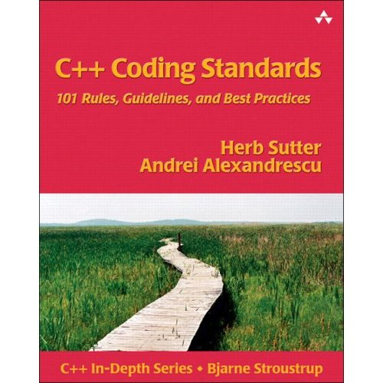
C++ Coding Guidelines
The first step in exercising software engineering principle is to follow the coding guidelines in the software development process
This is an art.
No universally correct
answer.
Google “C++ coding
guideline”...

Slide 10
Coding Style --- Naming (FYI)
Variable names
  numStudents, isDone...
Class names
  LuxuryCar, BinaraySearchTree,...
Function names
  checkNumber(), computeScore()...
#define / enum constant
  RANGE, MAX_COLORS,...
Class data members
  _name, _id, _score,...
Static, global variables / functions (optional)
  nameMap_g, count_s, _memMgr_s, checkSum_s()...

Slide 11
Coding Style --- Look and Feel (FYI)
Proper indentation
  3 (or 2, or 4) spaces right for the codes within a new scope
  Do not use “tab” ➔ platform dependent ➔ Use “space”
  Try to turn off “auto indentation”
Proper alignment
  if ((numStudents >= 30) &&
  (numStudents <= 80))
  cout << “Hello, today is “ << printDate()
  << “. Welcome to my world!!” << endl;
Braces { }
  void function()
  {
  }
  if (boolExpression) {
  }

Slide 12
Software Dependability
Facts
  Where there is a software, there is a bug.
  The only way to enhance software dependability is ➔ Test, and more tests.
Think:
  What is an “experienced” coder?
  Experience in:
    “Spontaneous coding” (but with GOOD coding styles)
    Debugging (to find the bug and to fix the bug)
  You must get yourself familiar with debugger!!!
The ultimate goal
  When you see the bug, you know the possible cause(s)
  No overnight (over-the-meal) bug

Slide 13
Software Dependability
Regression test
  A systematic mechanism to
    Collect and organize testcases
    Routinely run the testcases
    Make sure the newly added codes can still pass the testcases
    Check in new testcases for newly added codes
Source code version control
  A tool/database to centralize different versions of source codes
  Differences between different versions are recorded incrementally, with logs and histories for later reference

Slide 14
Software Efficiency
Facts
  80-20 rule
    80% (or more) resources (run time / memory) are consumed or controlled by 20% (or less) of the codes
  Don’t be picky about the efficiency of the 80% less critical codes
    Higher priorities: maintainability, dependability
    ➔ Even though they may have negative effects on the efficiency
    ➔ However, negligence on the maintainability and dependability may lead to unstructured codes and eventually jeopardize the efficiency
What you should do?
  Equip basic instincts about the implied complexity of the data structure and algorithm
  Know when to be picky and when to let go

Slide 15
Software Usability
Facts
  Usability factors = usage flow, user interface, ease of use, usage consistency
  80-20 rule
    80% (or more) of the code is not related to user friendliness
    However, 20% (or less) of the code determines how your program is appreciated by others
Importance of the minority
  Decisions about the above usability factors determine the architecture of the code/framework
  Later change is hard
  ➔ Plan at first!!

Slide 16
Discipline & Practice.
Take advantage of right tools and libraries
Make good use of proper data structures

Slide 17
Remember,
we have introduced several special types of Data Structures,
for example, list, array, set, map, hash, graph, etc.
People call them
Abstract Data Types (ADT)
or (an easier-to-understand name)
Container Classes

Slide 18
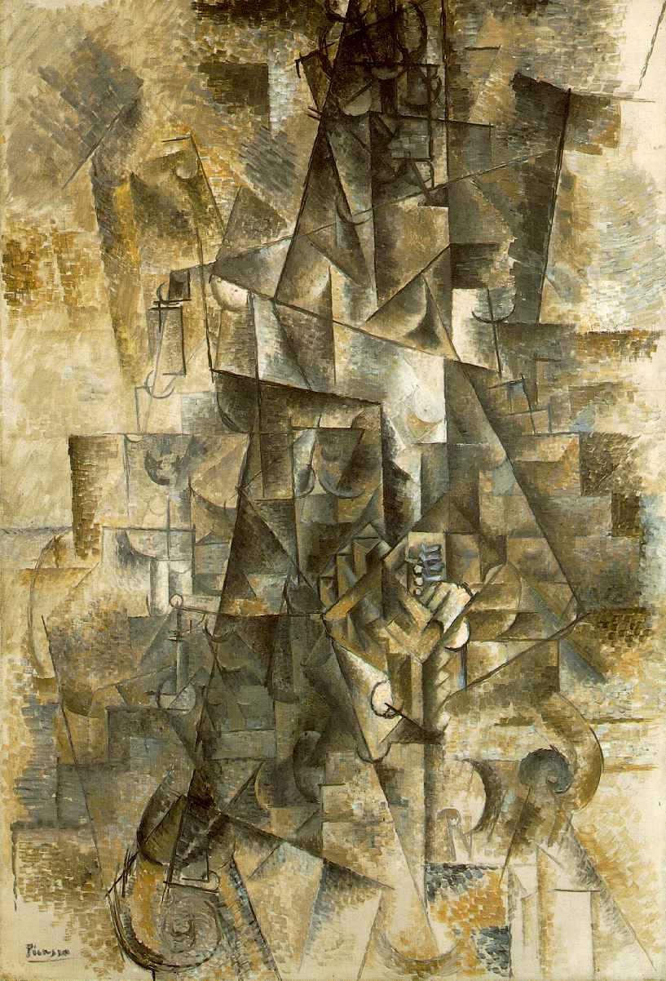
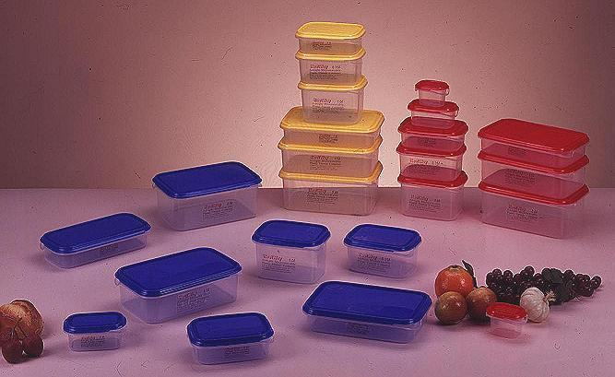
Saver Containers
Abstract ?? Containers??
Pablo Picasso, “Accordionist”

Slide 19
Abstraction
abstract model
Problem
.
abstraction
abstraction
.
Model
Notes:
選學生 男女朋友
自由落體

Slide 20
Data Types
“A data type, as defined in many object-oriented languages, is a class”
  Data member
    Define data
  Member functions
    Define operations
So, what does the “Abstract” in “Abstract Data Type” mean?

Slide 21
Some Quotes about ADT...
“...precisely specified independent of any particular implementation”
“You don't know how the ADT computes, but you know what it computes”
“The implementer of the class can change the implementation for maintenance, bug fixes or optimization reasons, without disturbing the client code”

Slide 22
ADT in Programming
Obviously, these kinds of classes are not specific to any type of algorithms
  In other words, they can be implemented independently of the algorithms that use them
What they provide ---
  Interface functions to operate on the data stored in the class
  The implied complexity of these functions
What they don’t show (Abstracted away...) ---
  What are the data members inside?
  How the functions are implemented?

Slide 23
ADT in Programming
That’s why they are called “Abstract Data Types”, or “Container Classes”, and usually treated as special “utilities” for a programmer
  Examples are:
    List, array, queue, stack, set, map, heap, hash, string, bit vector, matrix, tree, graph, etc.
The more and cleverer you use them, the better your program will be
  That’s the main purpose of learning this course

Slide 24
Recall: Classification of ADTs
Linear (Sequence) Data Types
  List, array, queue, stack
Associative Data Types
  Set, map, hash, heap
Topological Data Types
  Tree, graph
Miscellaneous Types
  String, bit vector, matrix
Usually OOP programmer will implement these classes just once (or adopt the existing ones), and later utilize them in various programs

Slide 25
Standard Template Library (STL)
First drafted by Alexander Stepanov and Meng Lee of HP in 1992
  Became IEEE standard in 1994
A C++ library of container classes, algorithms, and iterators
  Provides many of the basic algorithms and data structures of computer science
The STL is a generic library
  Platform independent
  Its components are heavily parameterized
  Almost every component in the STL is a template.
An useful reference: http://www.sgi.com/tech/stl/

Slide 26
With STL, people can…
Develop software without the need to implement in-house container classes
Create prototype more quickly
Share the programs with other easily
Port to different machine/OS platforms
[Note] However, in order to make STL generic, people sacrifice some performance and robustness
➔ Many commercial tools choose to implement their own TL’s.

Slide 27
Standard Template Library
Container classes
  list, slist, vector, deque, map, set, multimap, multiset, etc
  Adaptors: stack, queue, etc
  Non-template: string, bit_vector, etc
Iterators
  Trivial iterator, input iterator, output iterator, forward iterator, bidirectional iterator, random access iterator, etc
Algorithms
  for_each, sort, partial_sum, sort, find, copy, swap, etc.
Functional object
  plus, minus, less, greater, logical_and, etc
Utility
  Rational operators, pair, etc
Memory allocation
  alloc, pthread_alloc, construct, uninialized_copy, etc

Slide 28
STL Container Classes
list<T> | doubly-linked list
slist<T> | singly-linked list
vector<T> | dynamic array
deque<T> | vector + O(1) delete/remove front
map<K, V> | map K to V; 1 to 1
multimap<K, V> | map K to V; many to 1
set<T> | set of T type elements; no repeat
multiset<T> | set of T type elements; allow repeat

Slide 29
Iterators in STL
To manipulate data in STL, you need to know iterator first!
As its name suggests, iterator is to traverse data in a container class
  list<int>::iterator li;
  for (li = myList.begin(); li != myList.end(); li++) { … }
The STL defines several different concepts related to iterators, several predefined iterators, and a collection of types and functions for manipulating iterators.
  Different algorithms/functions may take different types of iterators

Slide 30
Operator Overload in Iterators
Let “li” be an iterator
*li | dereference to access the object
li++ | point to the next object in a range
li-- | point to the previous object in a range
li + n | point to the next n object in a range
li - n | point to the previous n object in a range

Slide 31
Hierarchy of Iterators
Container | Iterator type | Operators
list | bidirectional | *, ++, --
slist | forward | *, ++
vector | random access | *, ++, --, +/-
deque | random access | *, ++, --, +/-
map | bidirectional | *, ++, --
multimap | bidirectional | *, ++, --
set | bidirectional | *, ++, --
multiset | bidirectional | *, ++, --
Adaptors | none | N/A
Input
Output
forward
Bidirectional
Random access

Slide 32
Iterators (1/2)
A generalization of pointers
  They are objects that point to (data) objects in a class
  Often used to iterate over a range of objects
  ➔ If an iterator points to one element in a range, then it is possible to increment it so that it points to the next element
  e.g.
  list<int>::iterator li;
  for (li = myList.begin(); li != myList.end(); li++) { … }
Think: if “it” is currently pointing to a data in a container class, how does it move to the next data?
➔ Don’t need to reveal the internal implementation of the container class
  e.g. How does the data in “list<T>” get connected?
    Another class listNode<T>? Pointers?
    By “wrapping” the list nodes with iterators and providing interface functions (operators) like *, ++, --, we can traverse the list<T> without knowing how list<T> is implemented

Slide 33
Iterators (2/2)
An interface between containers and algorithms
  Algorithms typically take iterators as arguments, so a container needs only provide a way to access its elements using iterators.
  e.g.
  void sort(RandomAccessIterator first,
  RandomAccessIterator last,
  StrictWeakOrdering comp);
  ➔ Note: RandomAccessIterator does not tie to any container classes
Make your code container class independent
  typedef vector<int> MyContainer;
  ...
  MyContainer myData;
  for (MyContainer::iterator
  it = myData.begin();
  it != myData.end(); it++) { .... }

Slide 34
“end()” is actually “pass-the-end”
begin()
end()
end() points to the next to the last element
Why not the last element?
Think:
  for (li = L.begin(); li != L.end(); li++)...
    What’s the problem?
  for (li = L.begin(); li < L.end(); li++)...
    What’s the problem?

Slide 35
iterator vs. const_iterator
Think:
(*li) return the reference to the data
  *li = 10 ⬅ Can be used in LHS (writeable)
What if the container is a “const”?
  const list<int> ll;
  ...
  list<int>::iterator li = ll.begin();
  *li = 10; ⬅ Compile error!! (Why?)
“const_iterator” is to ensure (*li) return const reference to the data.
  const container MUST use const_iterator

Slide 36
STL Example #1
int arr[4] = { 3, 8, 4, 9 };
int main()
{
sort(arr, arr + 4, less<int>());
for (int i = 0; i < 4; i++)
cout << arr[i] << endl;
return 0;
}
Note:
void sort(RandomAccessIterator first,
  RandomAccessIterator last,
  StrictWeakOrdering comp);
Use “int*” as trivial iterators

Slide 37
STL Example #2
list<char> arr;
vector<int> brr;
…..
list<char>::iterator li;
for (li = arr.begin(); li != arr.end(); li++)
{ … }
vector<int>::iterator vi;
for (vi = brr.begin(); vi != brr.end(); vi++)
{ … *vi = 8; … }
for (size_t i = 0, n = brr.size(); i < n; ++i)
{ … brr[5] = 8; … }
// need to make sure brr.size() doesn’t change

Slide 38
STL Example #3
list<A*> ll;
ll.push_back(new A(3));
ll.push_front(new A(5));
…
while (!ll.empty()) { // cf. “.size()”
A* a = ll.front();
ll.pop_front();
...
delete a; // explicitly delete ‘a’
}

Slide 39
STL Example #4
vector<int> arr(10);
  // Initial size = 10
for (int i = 0; i < 10; ++i) arr[i] = i;
vector<int> arr;
arr[0] = 10; // crash!!! arr is an empty array
vector<int> arr;
arr.reserve(10);
  // Initial capacity = 10, size = 0
arr[0] = 10; // no crash; but not good...
  // size is still 0 ➔ Try: cout << arr.size() << endl;
vector<int> arr;
for (int i = 0; i < 10; ++i) arr.push_back(i);
vector<int> arr; arr.resize(10); // what’s the difference?
for (int i = 0; i < 10; ++i) arr[i] = i;
vector<int> arr; arr.reserve(10);// what’s the difference?
for (int i = 0; i < 10; ++i) arr.push_back(i);
vector<int> arr(5);
  // Initial size = 5
arr.resize(10);

Slide 40
STL Example #5
map<string, int> scores;
scores[“Mary”] = 100;
scores[“John”] = 97;
cout << scores[“Mary”] << endl;
map<const char*, int> scores;
scores[“Mary”] = 100;
scores[“John”] = 97;
cout << scores[“Mary”] << endl;
  // Not good; may get garbage; why?
map<string, int> scores;
scores[“Mary”] = 100;
  // What’s scores.size()?
cout << scores[“John”] << endl;
  // What will you see? Crash?
  // What’s scores.size()?

Slide 41
Example #6
If we want to know if someone is already in the map...
  map<string, int> scores;
  map<string, int>::iterator
  mi = scores.find(“John”) ;
  if (mi != scores.end()) // found!!
  cout << (*mi).first << “ = “
  << (*mi).second << endl;
  ➔ (*mi): pair<string, int>
  ➔ Don’t do (*mi) if NOT found!!
If we wants to insert something into the map, and wants to know if we succeed...
  map<string, int> scores;
  pair<map<string, int>::iterator, bool> p
  = scores.insert(make_pair(“John”, 100));
  // If succeeds, p.first = iterator to the newly inserted,
  // and p.second = true;
  // If fails, p.first = iterator to the existing object, ⬅ no overwrite
  // and p.second = false;

Slide 42
What is “pair”
template <class First, class Second>
struct pair
{
First first;
Second second;
};
The following are the same
scores.insert(make_pair("John", 100));
= scores.insert
(pair<string, int>("John", 100));
= scores.insert
(map<string, int>::value_type("John", 100));

Slide 43
Be careful when using map’s [ ] insertion...
Note that when we do:
scores[“Mary”] = 100; or
cout << scores[“John”] << endl;
we may insert a new element to the map if there is no element with the key value.
  No matter LHS or RHS
  Don’t use it to test the existence of an element
  This operator [] cannot be a const member function
  ➔ Can not be called if map is a const
Actually, m[k] is equivalent to
(*((m.insert(value_type(k, data_type()))).first)).second
➔ Strictly speaking, this member function is unnecessary: it exists only for convenience.

Slide 44
Conclusion
Learning software engineering
  Maintainability, dependability, efficiency, usability.
Abstract data structure (ADT)
  Implementation vs. user interface
Standard Template Library (STL)

